Slide 1
System Testing
Course Code: CSC4133
Course Title: Software Quality and Testing
Dept. of Computer Science
Faculty of Science and Technology
Lecturer No: | 20 | Week No: | 11 | Semester:
Lecturer: | Name & email

Slide 2
Lecture Outline
Basic Idea
Modeling Defects
Preparedness to Start System Testing
Metrics for Tracking System Test
Metrics for Monitoring Test execution
Metrics for Monitoring Defect Reports
Orthogonal Defect Classification
Defect Causal Analysis
Beta Testing
System Test Report
Measuring Test Effectiveness

Slide 3
Objectives and Outcomes
Objectives: To understand the basic concept of system testing, to understand defect modeling, to understand different types of metrics, to understand defect classification techniques.
Outcomes: Students are expected to be able to explain system testing, be able to explain severity and priority of a defect and the difference between them, be able to explain different types of metrics in system test execution.

Slide 4
Basic Idea
System testing is the testing of a complete and fully integrated software product. System testing is done after integration testing is completed. Its main focus is to verify that the customer requirements are fulfilled.
System testing tests the overall system operations as a whole, typically from a customer’s perspective. The primary concern is how the software system works as a whole under the operational environment of actual customers.
System testing presumes that all components have been previously, successfully, integrated.

Slide 5
Basic Idea
System testing should test functional and non-functional requirements of the software.
In system testing, the whole system is treated as a black-box, where external functions are tested.
System-level testing includes a wide range of tests. The test types followed in system testing differ from organization to organization.
System testing is black-box testing and often done by independent professional testers.

Slide 6
Basic Idea
Preparing for and executing system-level tests are a critical phase in a software development process, because –
− There is pressure to meet a tight schedule close to delivery date
− There is a need to discover most of the defects before delivering the product
− It is essential to verify that defect fixes are working and have not resulted in new defects

Slide 7
Basic Idea
It is important to monitor the processes of test execution and defect fixing. To be able to monitor those test processes, we define two key categories of metrics:
System test execution status
Defect status

Slide 8
Modeling Defects
A defect life-cycle model in the form of a state-transition diagram is shown in Figure 13.1.
The different states are briefly explained in Table 13.1
Two key concepts involved in modeling defects are the levels of priority and severity.
Priority and Severity assignments are separately done.
Q: What is the difference between priority & severity of a bug?

Slide 9
Priority & Severity of a Bug
Priority of a bug is how important/soon it is for a bug to be fixed.
− A priority level is a measure of how soon the defect needs to be fixed, i.e., urgency.
− Priority is the order in which developer has to fix the bug.
− Defect priority levels: Critical (1), High (2), Medium (3), Low(4)
Severity of a bug is a measure of how bad (impact) of the bug on the operation of the software
− A severity level is a measure of the extent of the detrimental effect of the defect on the operation of the product.
− Severity is how severly the bug is impacting the application.
− Defect severity levels: Critical (1), High (2), Medium (3), Low (4)

Slide 10

Life-cycle of a defect (“Bug Life-cycle”)
Figure 13.1: State-transition diagram representation of the life-cycle of a defect

Slide 11
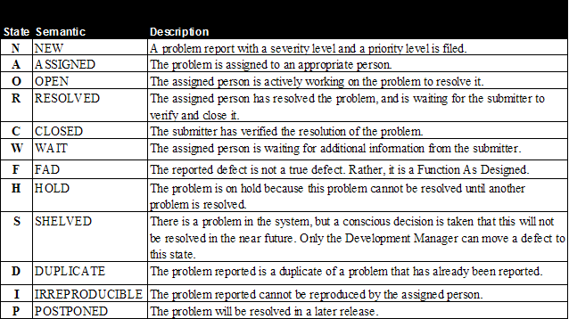
States of a defect

Slide 12
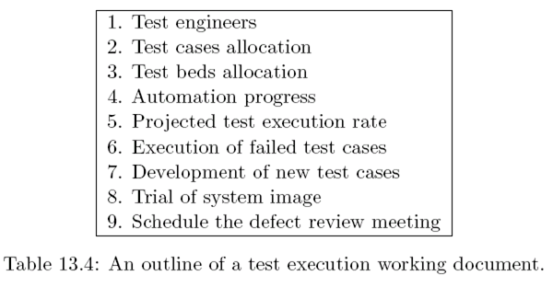
Preparedness to Start System Testing
The test execution working document should be in place and complete before the start of the system test.
The working document is created, controlled, and tracked by test lead.
A framework of such document is outlined in Table 13.4

Slide 13
Metrics for Tracking System Test
The system test execution brings forth different facets of software development. Developers would like to know the degree to which the system meets explicit as well as implicit requirements.
Delivery date can not be precisely predicted due to the uncertainty in fixing the problems.
Customer is excited to take the delivery of the product. It is a highly visible & exciting activity.
At this stage, it is desirable to monitor certain metrics which truly represent the progress of system testing & reveal the quality level of the system.
Based on those metrics, management can trigger actions for corrective & preventive measures.

Slide 14
Metrics for Tracking System Test
We categorized execution metrics into two classes:
Metrics for monitoring test execution – Concerns the process of executing test cases
Metrics for monitoring defects – Concerns the defects found as result of test execution

Slide 15
Metrics for Monitoring Test Execution
a) Test Case Escapes (TCE)
− A significant increase in the number of test case escapes implies that deficiencies in the test design
b) Planned versus Actual Execution (PAE) Rate
− Compare the actual number of test cases executed every week with the planned number of test cases
− Represents the productivity of the test team
c) Execution Status of Test (EST) Cases
− Periodically monitor the number of test cases lying in different states – Failed, Passed, Invalid and Untested
− Useful to further subdivide those numbers by test categories

Slide 16
Metrics for Monitoring Defect Reports
Function as Designed (FAD) Count
Irreproducible Defects (IRD) Count
Defects Arrival Rate (DAR) Count
Defects Rejected Rate (DRR) Count
Defects Closed Rate (DCR) Count
Outstanding Defects (OD) Count
Crash Defects (CD) Count
Arrival and Resolution of Defects (ARD) Count

Slide 17
Defect Analysis Techniques
Defect Causal Analysis
Orthogonal Defect Classification
Pareto Principle

Slide 18
Defect Analysis Techniques
1) Defect Causal Analysis(DCA):
Causal analysis is conducted to identify the root cause of the defects and to take actions to eliminate the sources of defects; this is done at the time of fixing defects.
Defects are analyzed to –
Determine the cause of an error
Take actions to prevent similar errors from occurring in the future
Remove similar defects that may exist in the system or detect them at earliest possible point in the software development process

Slide 19
Defect Analysis Techniques
2) Orthogonal Defect Classification(ODC):
A scheme for classifying software defects and guidance for analyzing the classified aggregate defect data.
In the ODC method, assessment is not done against individual defects; rather, trends & patterns in the aggregate data are studied.
ODC along with the application of Pareto analysis can give a good indication of which parts of the system are error prone and may require more testing.

Slide 20
Defect Analysis Techniques
3) Pareto Principle: “Concentrate on the vital few and not the trivial many”.
An alternative expression of the principle is to state that 80% of the problems can be fixed with 20% of the effort.
AKA “80-20 rule”
This principle guides us in efficiently utilizing the effort & resources.

Slide 21
Books
Software Testing and Quality Assurance: Theory and Practice, by Kshirasagar Naik, Priyadarshi Tripathy

Slide 22
References
Software Quality Assurance: From Theory to Implementation, by Daniel Galin
The Art of Software Testing, by Glenford J. Myers, Corey Sandler and Tom Badgett

